Slide 1
Profit Analysis

Slide 2
Business Performance Analytics
Comprehensive analysis of R&D, Marketing, and Administrative spending impact on profitability across New York, California, and Florida.
Dataset: 50 business records with regression analysis
Model Accuracy: 97.5% (R² = 0.9507)

Slide 3
Regression Analysis with Excel
Predictive Model Formula :
Profit(y)=(Rd_spend*0.8057) + (Administration * - 0.0268) + (Marketing spends * 0.0272) + (50122.19299)
+0.8057
R&D Coefficient
Strong Positive Impact
+0.0272
Marketing Coefficient
Moderate Positive Impact
-0.0268
Admin Coefficient
Negative Impact

Slide 4
Regression Model Metrics:
Multiple R
0.97
Observations
50
R Square
0.95
Adjusted R Square
0.94
Standard Error
9232.33

Slide 5
Predicted profit for given input feature:
RD_Spend | Administration | Marketing_spend | Predicted Profit
21892.92 | 81910.77 | 164270.7 | 70037.90477
23940.93 | 96489.63 | 137001.1 | 70554.57256

Slide 6
Visualize the data using Power Bi

Slide 7
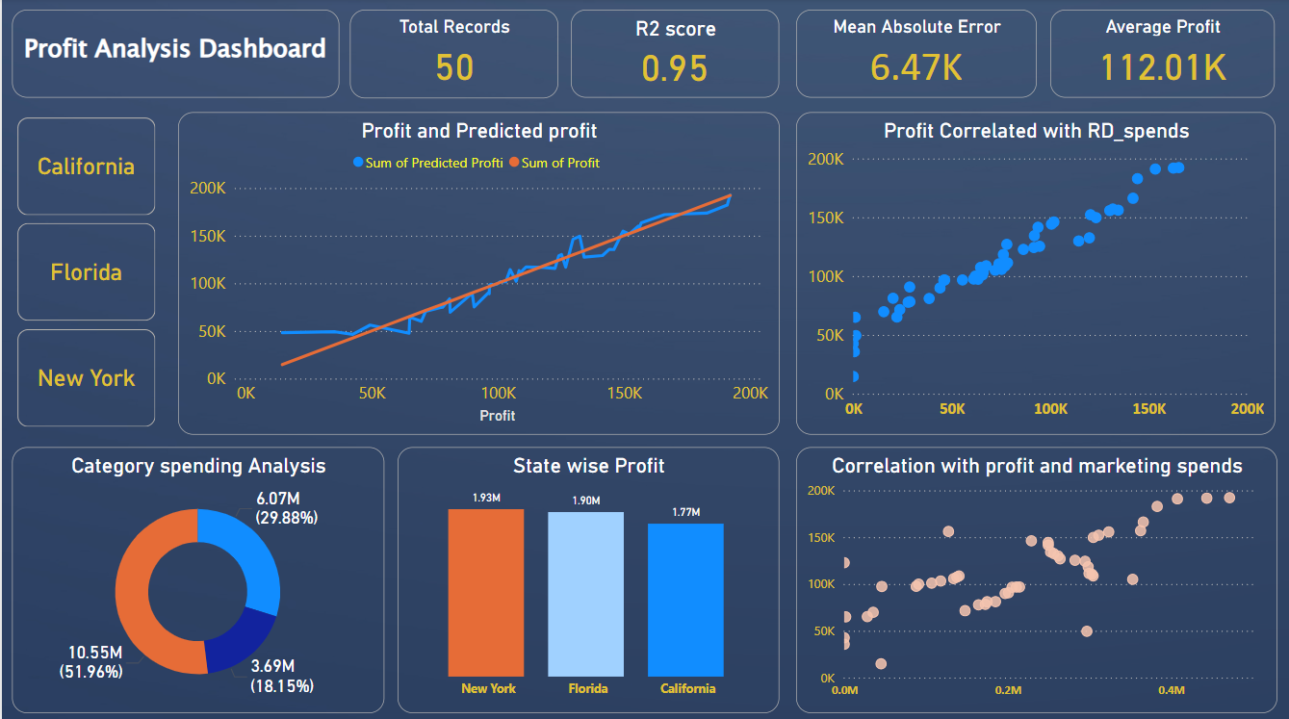

Slide 8
Dashboard Summary
• Total Records: 50
• R² Score: 0.95 (strong predictive model)
• Mean Absolute Error: 6.47K
• Average Profit: 112.01K
• Strong correlation between R&D spend
and profit.

Slide 9
State wise profit Distribution
. New York is the top-performing state
(1.93M total profit).
Followed by Florida (1.90M) and
California (1.77M).
Differences are marginal, suggesting
near-equal regional profitability.
insights :
New York leads in profitability .

Slide 10
Category spending analysis
R&D Spend: 18% (low)
Marketing Spend: 52%(most)
Administration: 30%
Insights:
Marketing is the biggest budget area and align with the moderate correlation with the profit .

Slide 11
🔍 Key Insights
R&D Spend is the Most Impactful
From the "Profit Correlated with RD_Spends" scatter plot, there's a strong positive correlation.
Higher R&D investments → higher profits.
2. Marketing Spend Has Moderate Influence
"Correlation with Profit and Marketing Spend" shows a positive trend, but with more scatter.
Marketing impacts profit but less consistently than R&D Spends.
Improves efficiency of marketing budget.

Slide 12
🔍 Key Insights
Administrative Optimization
Administrative costs negatively impact profit (-0.0268). This suggests overhead reduction opportunities and the need for operational efficiency improvements across all states.
Model Reliability
With 95% R2 score value, the prediction model is highly reliable. This strong correlation enables confident forecasting and strategic planning for future investments.

Slide 13
Strategic Recommendations
1. Increase R&D budget allocation.
2 . Optimize marketing spend efficiency.
Reallocate marketing spend to higher-ROI
channels
Methods: Digital transformation, data-driven
campaigns, customer segmentation.
3. Reduce administrative overhead.
4. Leverage New York success model in other states.
5. Embed the predictive model in financial planning
and forecasting.

Slide 14
Thank You

